Slide 1
Data Structures
Graph Theory

Slide 2
Graphs
In the real world, many problems are represented in terms of objects and connections between them
Example: Airline route map
A graph is a pair (V, E), where V is a set of nodes, called vertices, and £ is a collection of pairs of vertices, called edges.

Slide 3
Directed vs Undirected
Graphs with directed edges
Ordered pairs of vertices (u, v)
Where u is the origin and v the destination
Example: Route network, one-way road traffic
Graphs with undirected edges
Unordered pairs of vertices (u, v)
Example: Railway lines

Slide 4
Directed vs Undirected
Directed edges
Ordered pairs of vertices (u, v)
Where u is the origin and v the destination
Example: Route network, one-way road traffic
Undirected edges
Unordered pairs of vertices (u, v)
Example: Railway lines

Slide 5
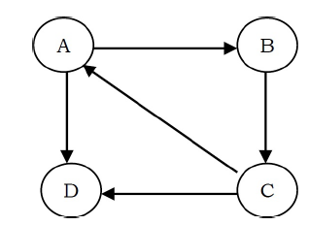

Directed vs Undirected
Directed Graph:
Undirected Graph:

Slide 6
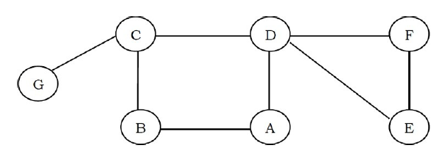
Adjacent vertices
When an edge connects two vertices, the vertices are said to be adjacent to each other

Slide 7
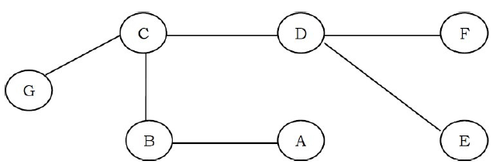
Trees
A graph with no cycles is called a tree. A tree is an acyclic connected graph

Slide 8
Applications
Representing relationships between components in electronic circuits
Transportation networks: Highway network, Flight network
Computer networks: Local area network, Internet, Web
Databases: For representing ER (Entity Relationship) diagrams in databases, for representing dependency of tables in databases

Slide 9
Graph Representation
We need to represent them in some useful form. Basically, there are three ways of doing this:
Adjacency Matrix
Adjacency List
Adjacency Set

Slide 10
Using Adjacency Matrix
In this method, we use a matrix with size NxN. The values of matrix are boolean. Let us assume the matrix is Adj. The value Adj[u, v] is set to 1 if there is an edge from vertex u to vertex v and 0 otherwise
An edge from u to v is represented by 1 value in both Adj[u,v ] and Adj[u,v]

Slide 11
Using Adjacency Matrix
We can assume that there is an “edge” from each vertex to itself. So, Adj[u, u] is set to 1 for all vertices
If the graph is a directed graph then we need to mark only one entry in the adjacency matrix
Suitable for dense graphs but wasted space for sparse graphs

Slide 12
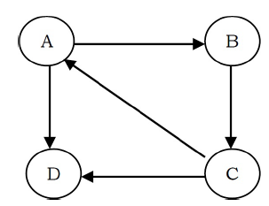
Example

Slide 13
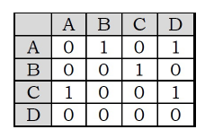
Example

Slide 14
Using Adjacency List
In this representation all the vertices connected to a vertex v are listed on an adjacency list for that vertex v. This can be easily implemented with linked lists
For each vertex v we use a linked list and list nodes represents the connections between v and other vertices to which v has an edge
Operations take more time (require traversals)

Slide 15
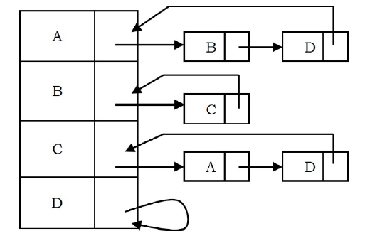
Example

Slide 16
Using Adjacency Set
Edges between vertices can be shown in terms of sets (one for each vertex)
The sets can be both ordered and unordered
Faster operations but cannot be used for parallel edges

Slide 17
Example

Slide 18
Graph Traversals
Graph traversal algorithms are also called graph search algorithms
Like trees traversal algorithms (Inorder, Preorder, Postorder and Level-Order traversals), graph search algorithms can be thought of as starting at some source vertex in a graph and “searching” the graph by going through the edges and marking the vertices

Slide 19
Graph Traversals
Two most common graph traversal schemes are:
Depth-first Traversal/Search
Breadth-first Traversal/Search

Slide 20
Depth First Search (DFS)
Depth First Search (DFS) algorithm traverses a graph in a depthward motion and uses a stack to remember to get the next vertex to start a search, when a dead end occurs in any iteration
DFS algorithm works in a manner similar to preorder traversal of the trees

Slide 21
Analogy
Suppose a person is trapped inside a maze. To come out from that maze, the person visits each path and each intersection (in the worst case)
The person uses two colors of paint to mark the intersections already passed. When discovering a new intersection, it is marked grey, and he continues to go deeper

Slide 22
Analogy
After reaching a “dead end” the person knows that there is no more unexplored path from the grey intersection, which now is completed, and he marks it with black
This “dead end” is either an intersection which has already been marked grey or black, or simply a path that does not lead to an intersection
The intersections of the maze are the vertices and the paths between the intersections are the edges of the graph. The process of returning from the “dead end” is backtracking

Slide 23
Algorithm
Step 1: Visit the adjacent unvisited vertex. Mark it as visited. Display it. Push it in a stack.
Step 2: If no adjacent vertex is found, pop up a vertex from the stack. (It will pop up all the vertices from the stack, which do not have adjacent vertices.)
Step 3: Repeat Step 1 and Step 2 until the stack is empty

Slide 24
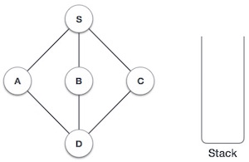
Example
Initialize the stack.

Slide 25
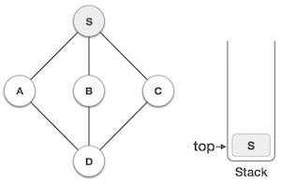
Example
Mark S as visited and put it onto the stack. Explore any unvisited adjacent node from S

Slide 26
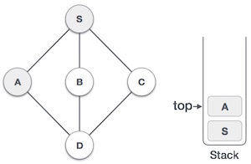
Example
Mark A as visited and put it onto the stack. Explore any unvisited adjacent node from A. Both S and D are adjacent to A but we are concerned for unvisited nodes only

Slide 27
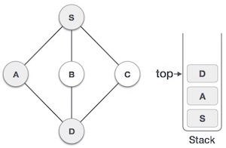
Example
Visit D and mark it as visited and put onto the stack. Here, we have B and C nodes, which are adjacent to D and both are unvisited. Let’s pick B

Slide 28
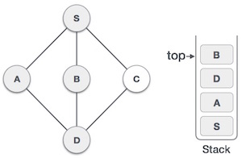
Example
We choose B, mark it as visited and put onto the stack. Here B does not have any unvisited adjacent node. So, we pop B from the stack

Slide 29
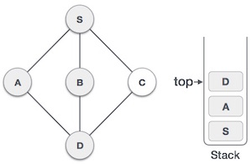
Example
We check the stack top for return to the previous node and check if it has any unvisited nodes. Here, we find D to be on the top of stack

Slide 30
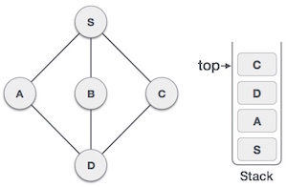
Example
Only unvisited adjacent node is from D is C now. So we visit C, mark it as visited and put it onto the stack

Slide 31
Example
As C does not have any unvisited adjacent node so we keep popping the stack until we find a node that has an unvisited adjacent node. In this case, there's none and we keep popping until the stack is empty

Slide 32
Breadth First Search (BFS)
BFS algorithm traverses a graph in a breadthward motion and uses a queue to remember to get the next vertex to start a search, when a dead end occurs in any iteration
The BFS algorithm works similar to level-order traversal of the trees

Slide 33
Algorithm
Step 1: Visit the adjacent unvisited vertex. Mark it as visited. Display it. Insert it in a queue.
Step 2: If no adjacent vertex is found, remove the first vertex from the queue.
Step 3: Repeat Step 1 and Step 2 until the queue is empty.

Slide 34
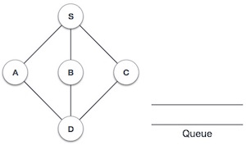
Example
Initialize the queue

Slide 35
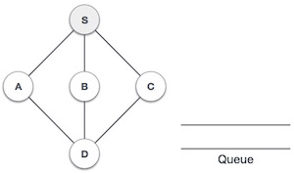
Example
We start from visiting S (starting node), and mark it as visited

Slide 36
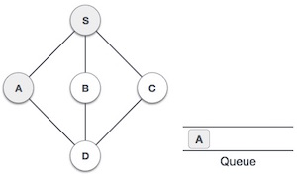
Example
We then see an unvisited adjacent node from S. We have three such nodes, we pick A at random, mark it as visited and enqueue it

Slide 37
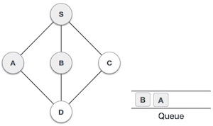
Example
Next, the unvisited adjacent node from S is B. We mark it as visited and enqueue it

Slide 38
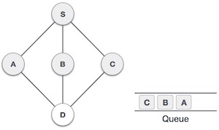
Example
Next, the unvisited adjacent node from S is C. We mark it as visited and enqueue it

Slide 39
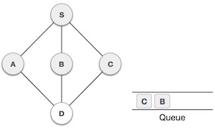
Example
Now, S is left with no unvisited adjacent nodes. So, we dequeue and find A

Slide 40
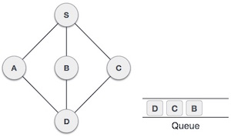
Example
From A we have D as unvisited adjacent node. We mark it as visited and enqueue it

Slide 41
Example
At this stage, we are left with no unmarked (unvisited) nodes. But as per the algorithm we keep on dequeuing in order to get all unvisited nodes. When the queue gets emptied, the algorithm terminates

Slide 42
Topological Sort
Topological Sort is a linear ordering of the vertices in such a way that if there is an edge in the DAG going from vertex ‘u’ to vertex ‘v’, then ‘u’ comes before ‘v’ in the ordering

Slide 43
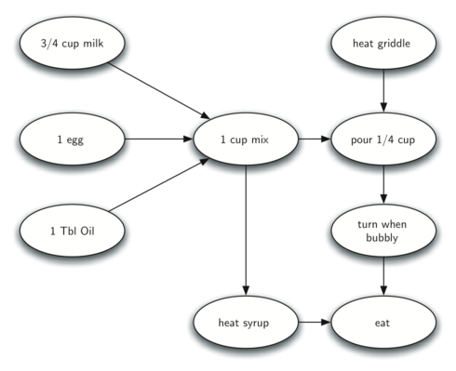
Analogy
The difficult thing about making pancakes is knowing what to do first

Slide 44
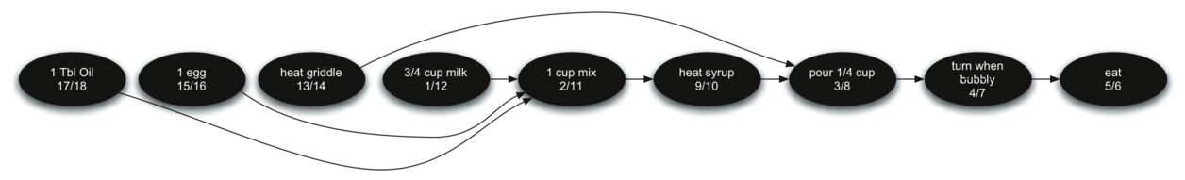
Analogy
Topological Sort helps remove ambiguity and we know exactly the order in which to perform the pancake making steps

Slide 45
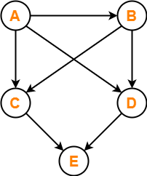
Example
Consider the graph:

Slide 46
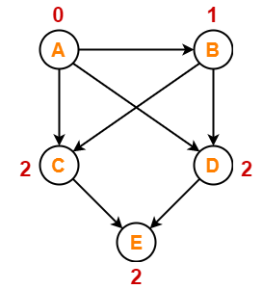
Example
Write in-degree of each vertex

Slide 47
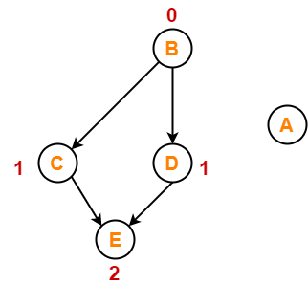
Example
Vertex-A has the least in-degree.
Remove vertex-A and its associated edges.
Update the in-degree of other vertices.

Slide 48
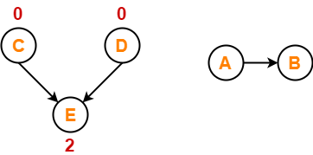
Example
Vertex-B has the least in-degree.
So, remove vertex-B and its associated edges.
Now, update the in-degree of other vertices.

Slide 49
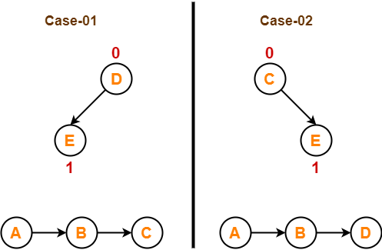
Example
There are two vertices with the least in-degree. So, following 2 cases are possible

Slide 50
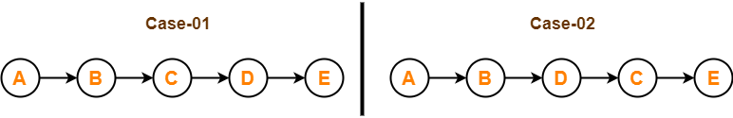
Example
Case 1:
Remove vertex-C and its associated edges.
Then, update the in-degree of other vertices.
Case 2:
Remove vertex-D and its associated edges.
Then, update the in-degree of other vertices.

